Slide 1

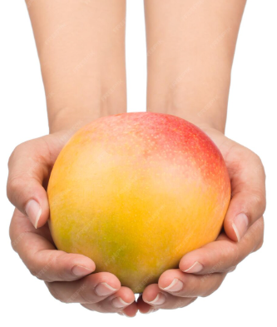

EXCELLENCE PROGRAM

Slide 2

Solar IoT–Integrated Mango Drying & Inventory Management

Slide 3
Plan
Solar IoT–Integrated Drying
1
Facility Sizing & Production Metrics
2
Comprehensive Inventory Management
2
Monitoring App
3
German Market Compliance
4
Energy Supply Systems: Solar PV power plant and Solar Tracking
5
6
Visitors management :No-Reesa Voice Translator
7
Fencing and Security: Face Recognition

Slide 4




Solar IoT–Integrated Drying
Addressing Critical Quality Issues
Mangoes spoil rapidly, with quality degradation occurring within hours of harvest. Our smart dryer system is specifically optimized for mango preservation.
Controlled Environment
IoT Monitoring
Precise temperature & humidity management with real time alerts
Infineon XENSIV sensors (DPS368, SHT35), Mobile Application
Energy Efficiency
Optimized airflow design with data logging
Result: Preserves essential nutrients, extends shelf life significantly, and reduces waste by up to 50%.

Slide 5
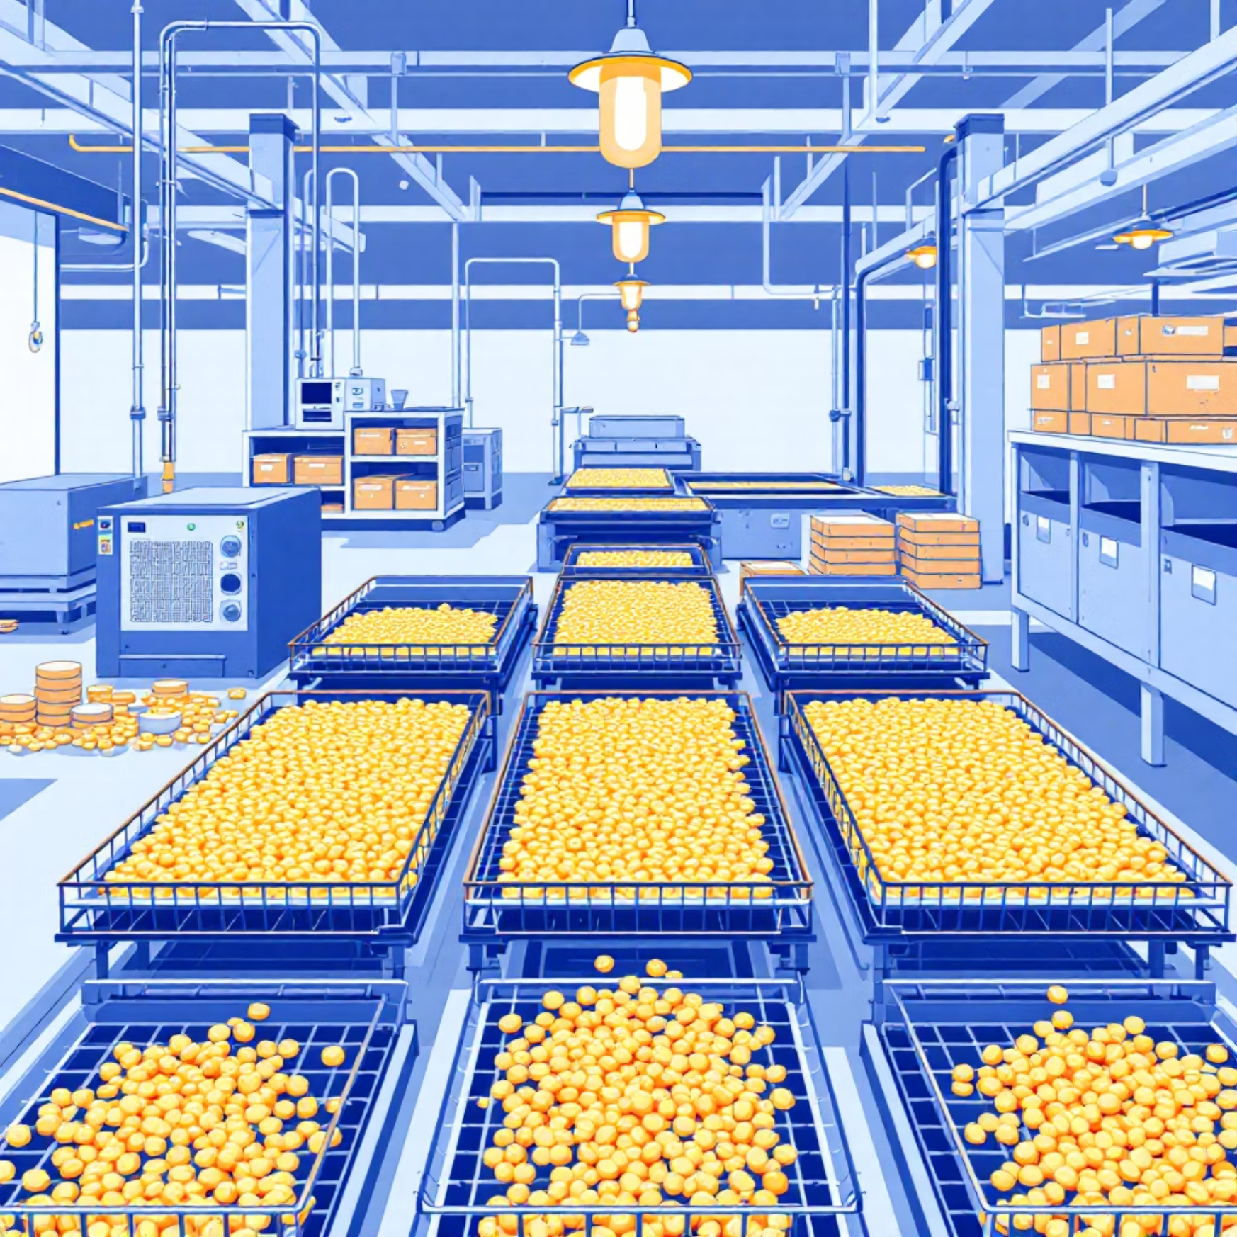
Facility Sizing & Production Metrics
85%
5.25:1
175kg
Fresh Mango Water
Conversion Ratio
Daily Fresh Input
Reduced to 12% target moisture
Fresh to dried weight (including 10% peel loss)
To produce 1 ton dried mango monthly
Scalable Infrastructure Design
20–30 m² modular tray area capacity
12-hour drying cycles, 16-hour daily operation
Energy consumption: 0.77 kWh per kg fresh input
Monthly energy requirement: 3,600 kWh

Slide 6






Comprehensive Inventory Management
Harvest Tracking
Each batch recorded from source farm with GPS coordinates and quality metrics
Processing Monitoring
Real-time tracking of fresh input vs dried output with automated yield calculations
Smart Storage
Continuous warehouse condition monitoring with FIFO lot traceability protocols
Export Ready
Automatic generation of EU compliance documentation and shipping manifests
Digital Twin Concept: Every physical pallet corresponds to a comprehensive digital entry in our system, enabling complete supply chain visibility.

Slide 7
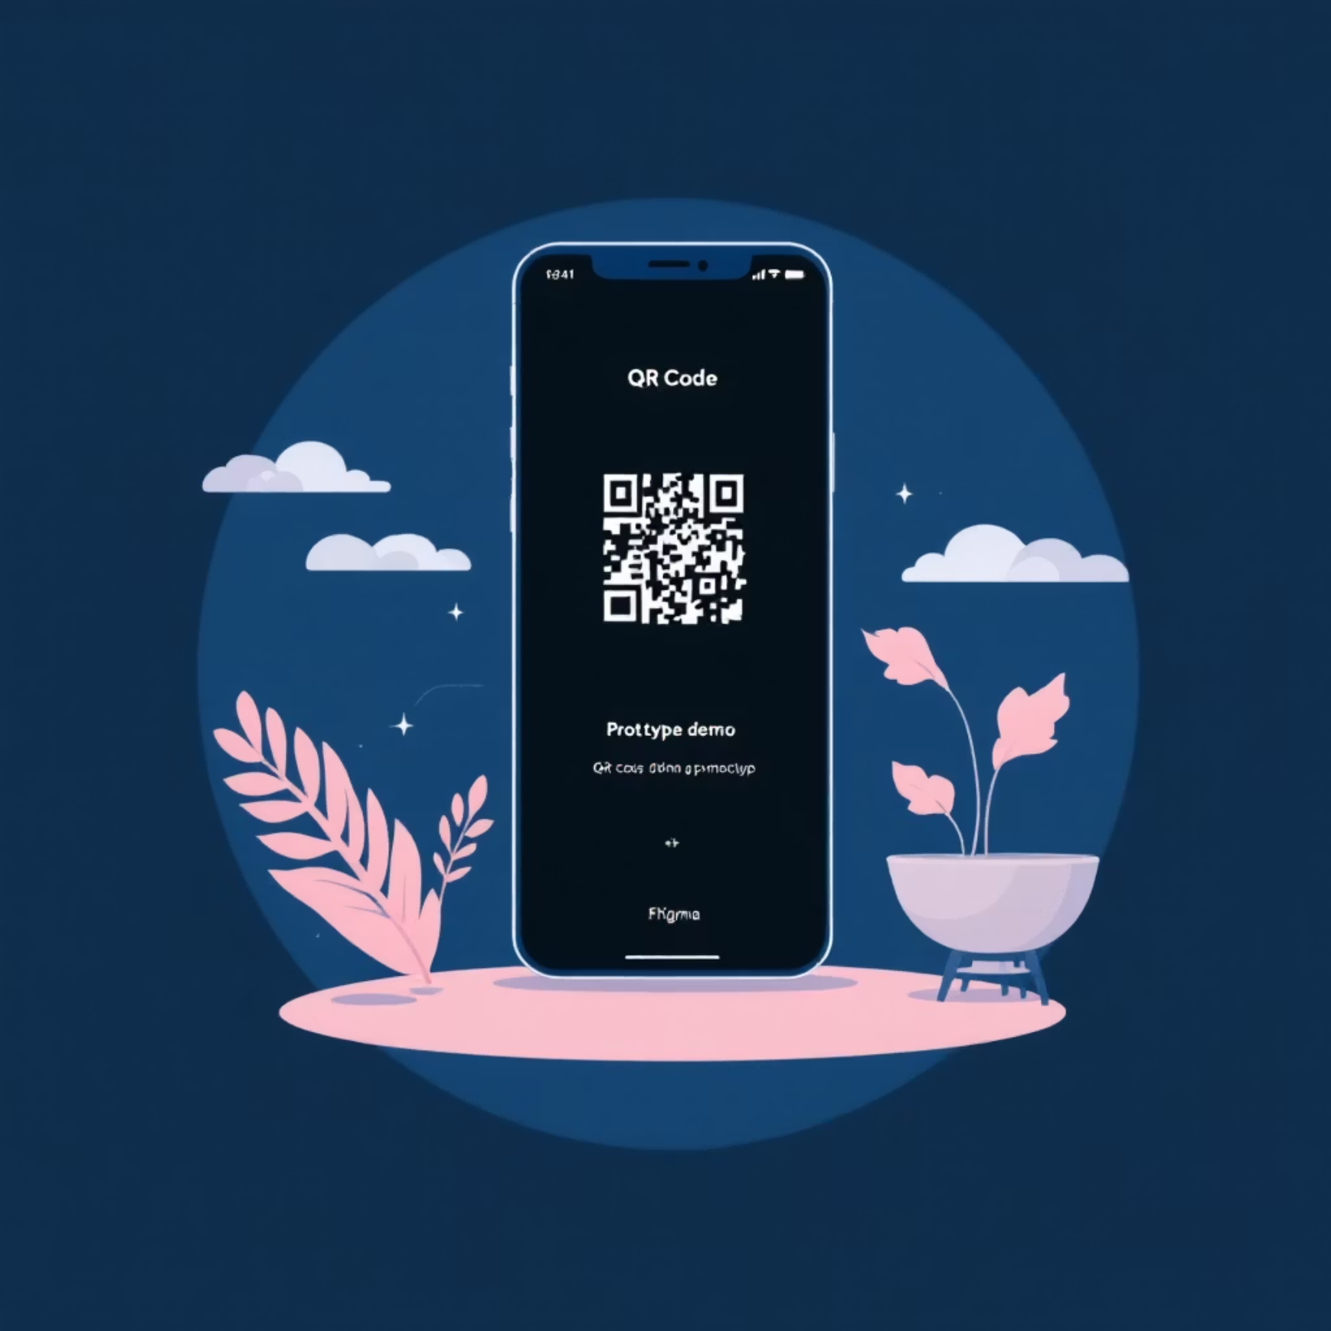

Monitoring App
Access the app prototype by scanning the below qr code
Our app leverages proven UX patterns from successful agricultural monitoring applications.
1
Real-Time Dashboard
Live sensor data display with temperature, humidity, and GPS location tracking
2
Predictive Analytics
Dr. Joyce algorithm implementation for accurate shelf-life prediction and quality forecasting
3
Alert Management
Persistent notifications requiring acknowledgment with pallet-level granularity
4
Export Readiness
Visual indicators (Green/Amber/Red) for immediate quality assessment

Slide 8





German Market Compliance
Moisture Control
Chemical Compliance
Strict adherence to ≤15% moisture content requirements with automated monitoring and verification
Sulfite limits maintained at ≤2000 ppm when applied, with comprehensive pesticide residue testing protocols
HACCP Certification
Fully certified facility operations with continuous digital logging for audit trail transparency
Competitive Advantage: Our smart dryer and app combination provides automatic compliance evidence, building crucial buyer trust with German importers and premium supermarket chains.

Slide 9
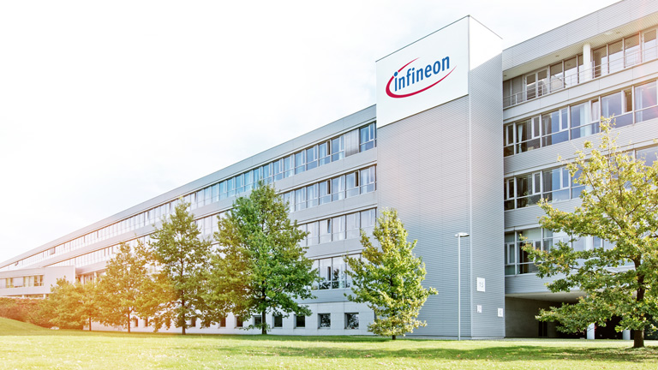

THANK YOU

